Slide 1


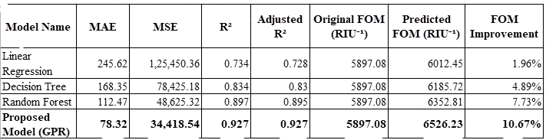
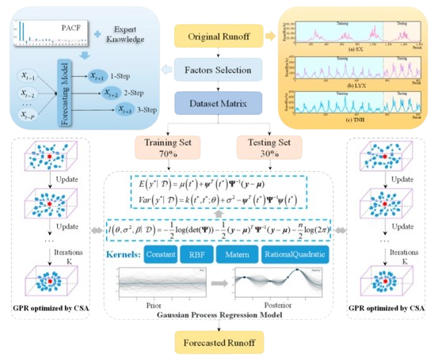
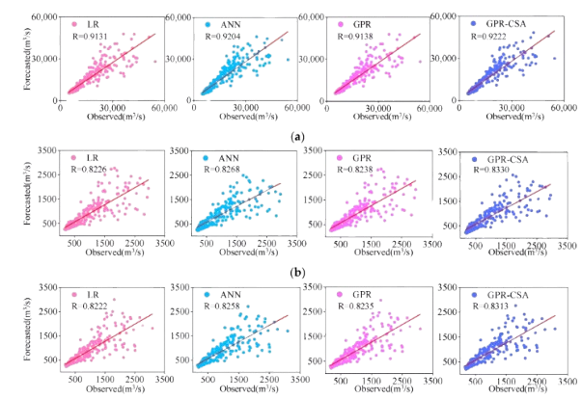
Enhancing the Figure of Merit of Photonic Sensors Through Machine Learning-Based Optimization
Author name, roll number, Mail id
Department name, Institute name
Abstract
Key Contributions
Result and Discussion
This work explores machine learning techniques to enhance the performance of fiber-optic SPR sensors. Various regression models are evaluated to predict the figure of merit (FOM) using wavelength and metal layer thickness. Gaussian Process Regression (GPR) achieves predicted FOM improvements of up to 10.67%. The results demonstrate improved sensor performance with significantly reduced computational time.
Developed a Gaussian Process Regression (GPR) approach to optimize the figure of merit (FOM) of MoS₂-based fiber-optic SPR sensors.
Achieved a predicted FOM improvement of 10.67% by refining wavelength resolution from 0.01 nm to 0.001 nm.
Reduced computational time from approximately 55 hours to 3.79 seconds, enabling rapid sensor design optimization.
Table 1: Proposed model results compare to baseline
Methodology
Introduction
Fiber-optic SPR sensors offer high sensitivity and accuracy for biosensing and environmental monitoring applications [1].
Conventional sensor optimization requires extensive simulations, resulting in high computational time and limited wavelength resolution [2].
ML-based regression models enable accurate prediction of the figure of merit (FOM), improving sensor performance while reducing computational complexity.
Figure 1: End to end Architecture of GPR
Algorithm 1: ML-Based Photonic Sensor Optimization
Require: Dataset D = {(λᵢ, dmᵢ, FOMᵢ)}, i = 1..N; wavelength grid Λ; metal-thickness grid Dm
Ensure: Optimal (λ*, dm*) and FOM_max
1. Split D into 80% training and 20% testing sets.
2. Train LR, DT, RF, XGBoost and GPR; compute R², MAE and RMSE on the test set.
3. Select the best model m* by test R² (GPR with RBF kernel).
4. Set FOM_max ← −∞.
5. For each (λ, dm) in Λ × Dm:
  Predict FOM = m*(λ, dm).
  If FOM > FOM_max, then set FOM_max ← FOM and (λ*, dm*) ← (λ, dm).
6. Return (λ*, dm*, FOM_max).
Problem Statement
Conclusion
Conventional photonic sensor optimization is computationally expensive and limited in resolution, requiring efficient machine learning approaches to enhance sensor performance.
The GPR model enhances photonic sensor performance with a predicted FOM improvement of 10.67%, demonstrating accurate and efficient sensor optimization.
References:
[1] Butt, M. A., Kazanskiy, N. L., Khonina, S. N., Voronkov, G. S., Grakhova, E. P., & Kutluyarov, R. V. (2023). A review on photonic sensing technologies: status and outlook. Biosensors, 13(5), 568.
[2] Franck, T., Augusto, V., Xie, X., & Gonthier, R. (2021). A Stochastic Optimization Approach to the Long-Term Care Structure Assignment Problem for Elderly People. IEEE Transactions on Automation Science and Engineering, 19(3), 1898-1912.

